Slide 1

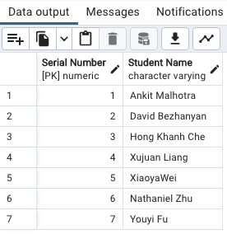
Heptagon Database: Transforming Business Management
Presented by
The Heptagon Consulting Group
MGT 286A
Group 4

Slide 2

Introduction
Welcome to Heptagon Database

Slide 3
Introduction of HBMC Database
Comprehensive Data Management
Centralized platform for client, consultant, project, and skillset data
Streamlines tracking and management of key operational information
Dynamic Onboarding and Administration
Facilitates easy addition of new clients and projects.
Enables effective oversight of client relationships and consultant assignments.
Optimized Resource Allocation
Matches consultants to projects based on specific expertise.
Enhances project efficiency and success rates.
Enhanced Decision-Making and Growth
Supports sophisticated information management and business process streamlining.
Contributes to strategic decision-making and fosters overall business development.
Notes:
The Heptagon Business Management Consulting Database is an all-encompassing platform tailored to streamline the management and growth of consulting operations. It integrates crucial data across clients, consultants, projects, and more, enabling seamless data tracking and management. This system supports the dynamic nature of consulting by simplifying the onboarding of new clients and projects, and it empowers managers to effectively oversee client relationships, consultant expertise, and project execution. Additionally, the database optimizes project outcomes by matching consultants to projects based on their skill sets, thereby enhancing operational efficiency and fostering business growth through improved decision-making and sophisticated information management.

Slide 4

The Details of Database Design

Slide 5




Clients
Projects_Details
Employees
Consultant
ClientID
ClientDetailsId
ClientName
TypeOfClient
Industry
sizeOfCompany
ProjectID,
Name
ConsultantID
SkillsetRequirement,
Start/end date,
Status, and
Budget
EmployeeID
Last/first name
Designation,
ConsultantID
Address
DepartmentID
Gender
Primary_skill
etc
ConsultantID,
Last/First name
Email
ProjectID
Expertise

Slide 6



Clients_Relationship_Details
SkillSets
Department
Skillset_id
Skillset_name
DepartmentID
DepartmentName
Number of employees
ManagerID
ClientDetailID
Phone number
Email
Street
Apt
State
and etc
7 Tables In total

Slide 7
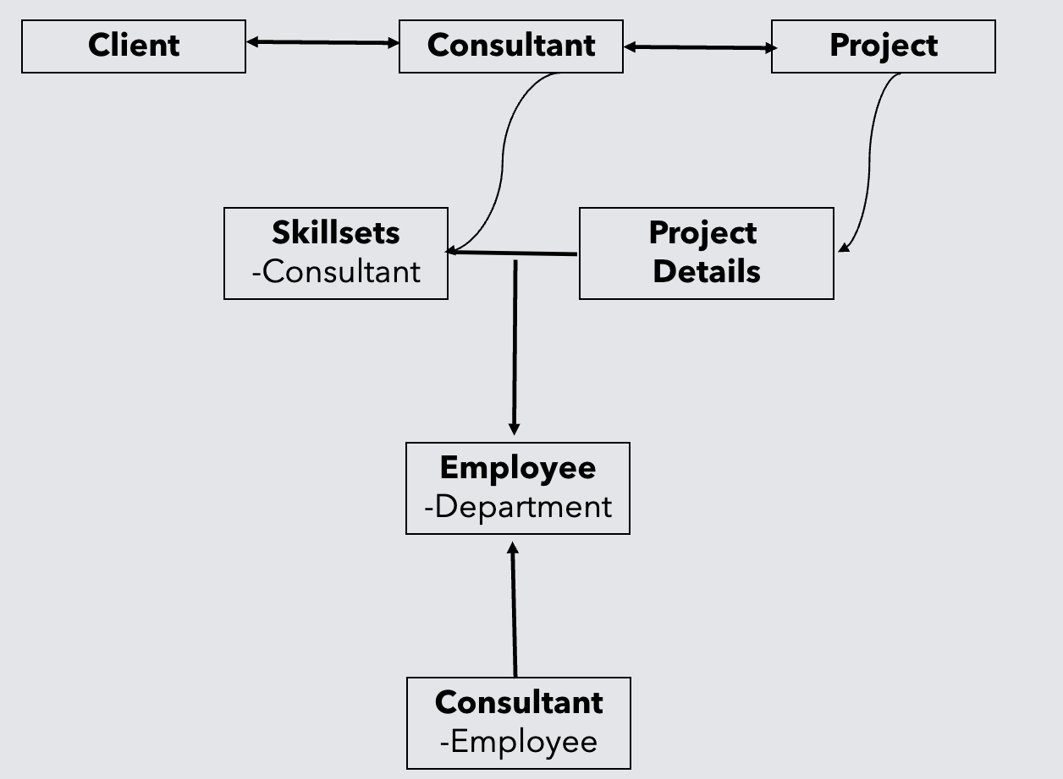
Logical Model-Intros and relationships
For the logical data model, the Heptagon Business Management Consulting Database specifies the entities, attributes, and relationships in a visual form. Names are given to entities and attributes based on how they are actually used in our database.
Tables: Client, Client_relationship, Consultant, Department, Employee, Project details, Skillsets.
Relationships:
Client - Consultant Relationship (Many-to-Many)
Client - Project Relationship (One-to-Many)
Consultant - Project Relationship (Many-to-Many)
Consultant - Skillset Relationship (Many-to-Many)
Employee - Department (Many-to-One)
Consultant - Employee (One-to-One)
Notes:
The Heptagon Business Management Consulting Database is an all-encompassing platform tailored to streamline the management and growth of consulting operations. It integrates crucial data across clients, consultants, projects, and more, enabling seamless data tracking and management. This system supports the dynamic nature of consulting by simplifying the onboarding of new clients and projects, and it empowers managers to effectively oversee client relationships, consultant expertise, and project execution. Additionally, the database optimizes project outcomes by matching consultants to projects based on their skill sets, thereby enhancing operational efficiency and fostering business growth through improved decision-making and sophisticated information management.

Slide 8
Logical Model (cont.)
Tables: Client, Client_relationship, Consultant, Department, Employee, Project details, Skillsets.
3. Table: Consultant
consultantId (Primary Key）
consultantLastName
consultantFirstName
consultantPhone
consultantEmail
projectId (Foreign Key)
expertise
4. Table: Department
departmentId (Primary Key)
departmentName
numberOfEmployees
Location
5. Table: Employee
employeeid
employeeLastName
employeeFirstName
designation
consultantID
address
departmentld
gender
DOB
primary_Skill_ID
6. Table: Project details
projectID
projectName
consultantId
clientID
skillSetRequirement
7. Table: Skillsets.
skilled (Primary Key）
skillName
1. Table: Client
clientId (Primary Key)
clientDetailsId (Foreign Key)
clientName
typeOfClient
industry
SizeOfCompany
2. Table: Client_relationship
clientDetailsid (Primary Key)
clientPhoneNumber
clientEmail
street
apt
state
zipcode

Slide 9
Physical Model
Tables: Client, Client_relationship, Consultant, Department, Employee, Project details, Skillsets.
1.Table : Client
clientId (Primary Key, INT)
clientDetailsId (Foreign Key, INT)
clientName ((VARCHAR(500))
typeOfClient (CHAR(100))
industry ((VARCHAR(100))
sizeOfCompany (CHAR(10))
2. Table: Client_relationship
clientDetailsid (Primary Key, INT)
clientPhoneNumber (VARCHAR(20)
clientEmail (VARCHAR(100))
street (CHAR(100))
apt (CHAR(11))
state (CHAR(2))
zipcode (INT)
3. Table: Consultant
consultantId (Primary Key, INT）
consultantLastName (VARCHAR(100))
consultantFirstName (VARCHAR(100))
consultantPhone (VARCHAR(20))
consultantEmail (VARCHAR(100)
projectId (Foreign Key, INT)
expertise (CHAR(100))
4. Table: Department
departmentId (Primary Key, INT)
departmentName (CHAR(100))
numberOfEmployees (INT(11))
Location (CHAR(100))
5. Table: Employee
employeeid(primary key, INT(11))
employeeLastName(VARCHAR(100))
employeeFirstName(VARCHAR(100))
designation(VARCHAR(100))
consultantID(INT(11))
address(VARCHAR(100))
departmentld(INT(11))
gender(CHAR(1))
DOB(TIMESTAMP(19))
primary_Skill_ID(INT(11))
6. Table: Project details
projectID(VARCHAR(20))
projectName(CHAR(100))
consultantId(INT(11))
clientID(INT(11))
skillSetRequirement(TEXT(65535))
7. Table: Skillsets.
skilled (Primary Key, INT）
skillName (VARCHAR(100)
Notes:
The Heptagon Business Management Consulting Database is an all-encompassing platform tailored to streamline the management and growth of consulting operations. It integrates crucial data across clients, consultants, projects, and more, enabling seamless data tracking and management. This system supports the dynamic nature of consulting by simplifying the onboarding of new clients and projects, and it empowers managers to effectively oversee client relationships, consultant expertise, and project execution. Additionally, the database optimizes project outcomes by matching consultants to projects based on their skill sets, thereby enhancing operational efficiency and fostering business growth through improved decision-making and sophisticated information management.

Slide 10

Let's see some actual diagrams!

Slide 11
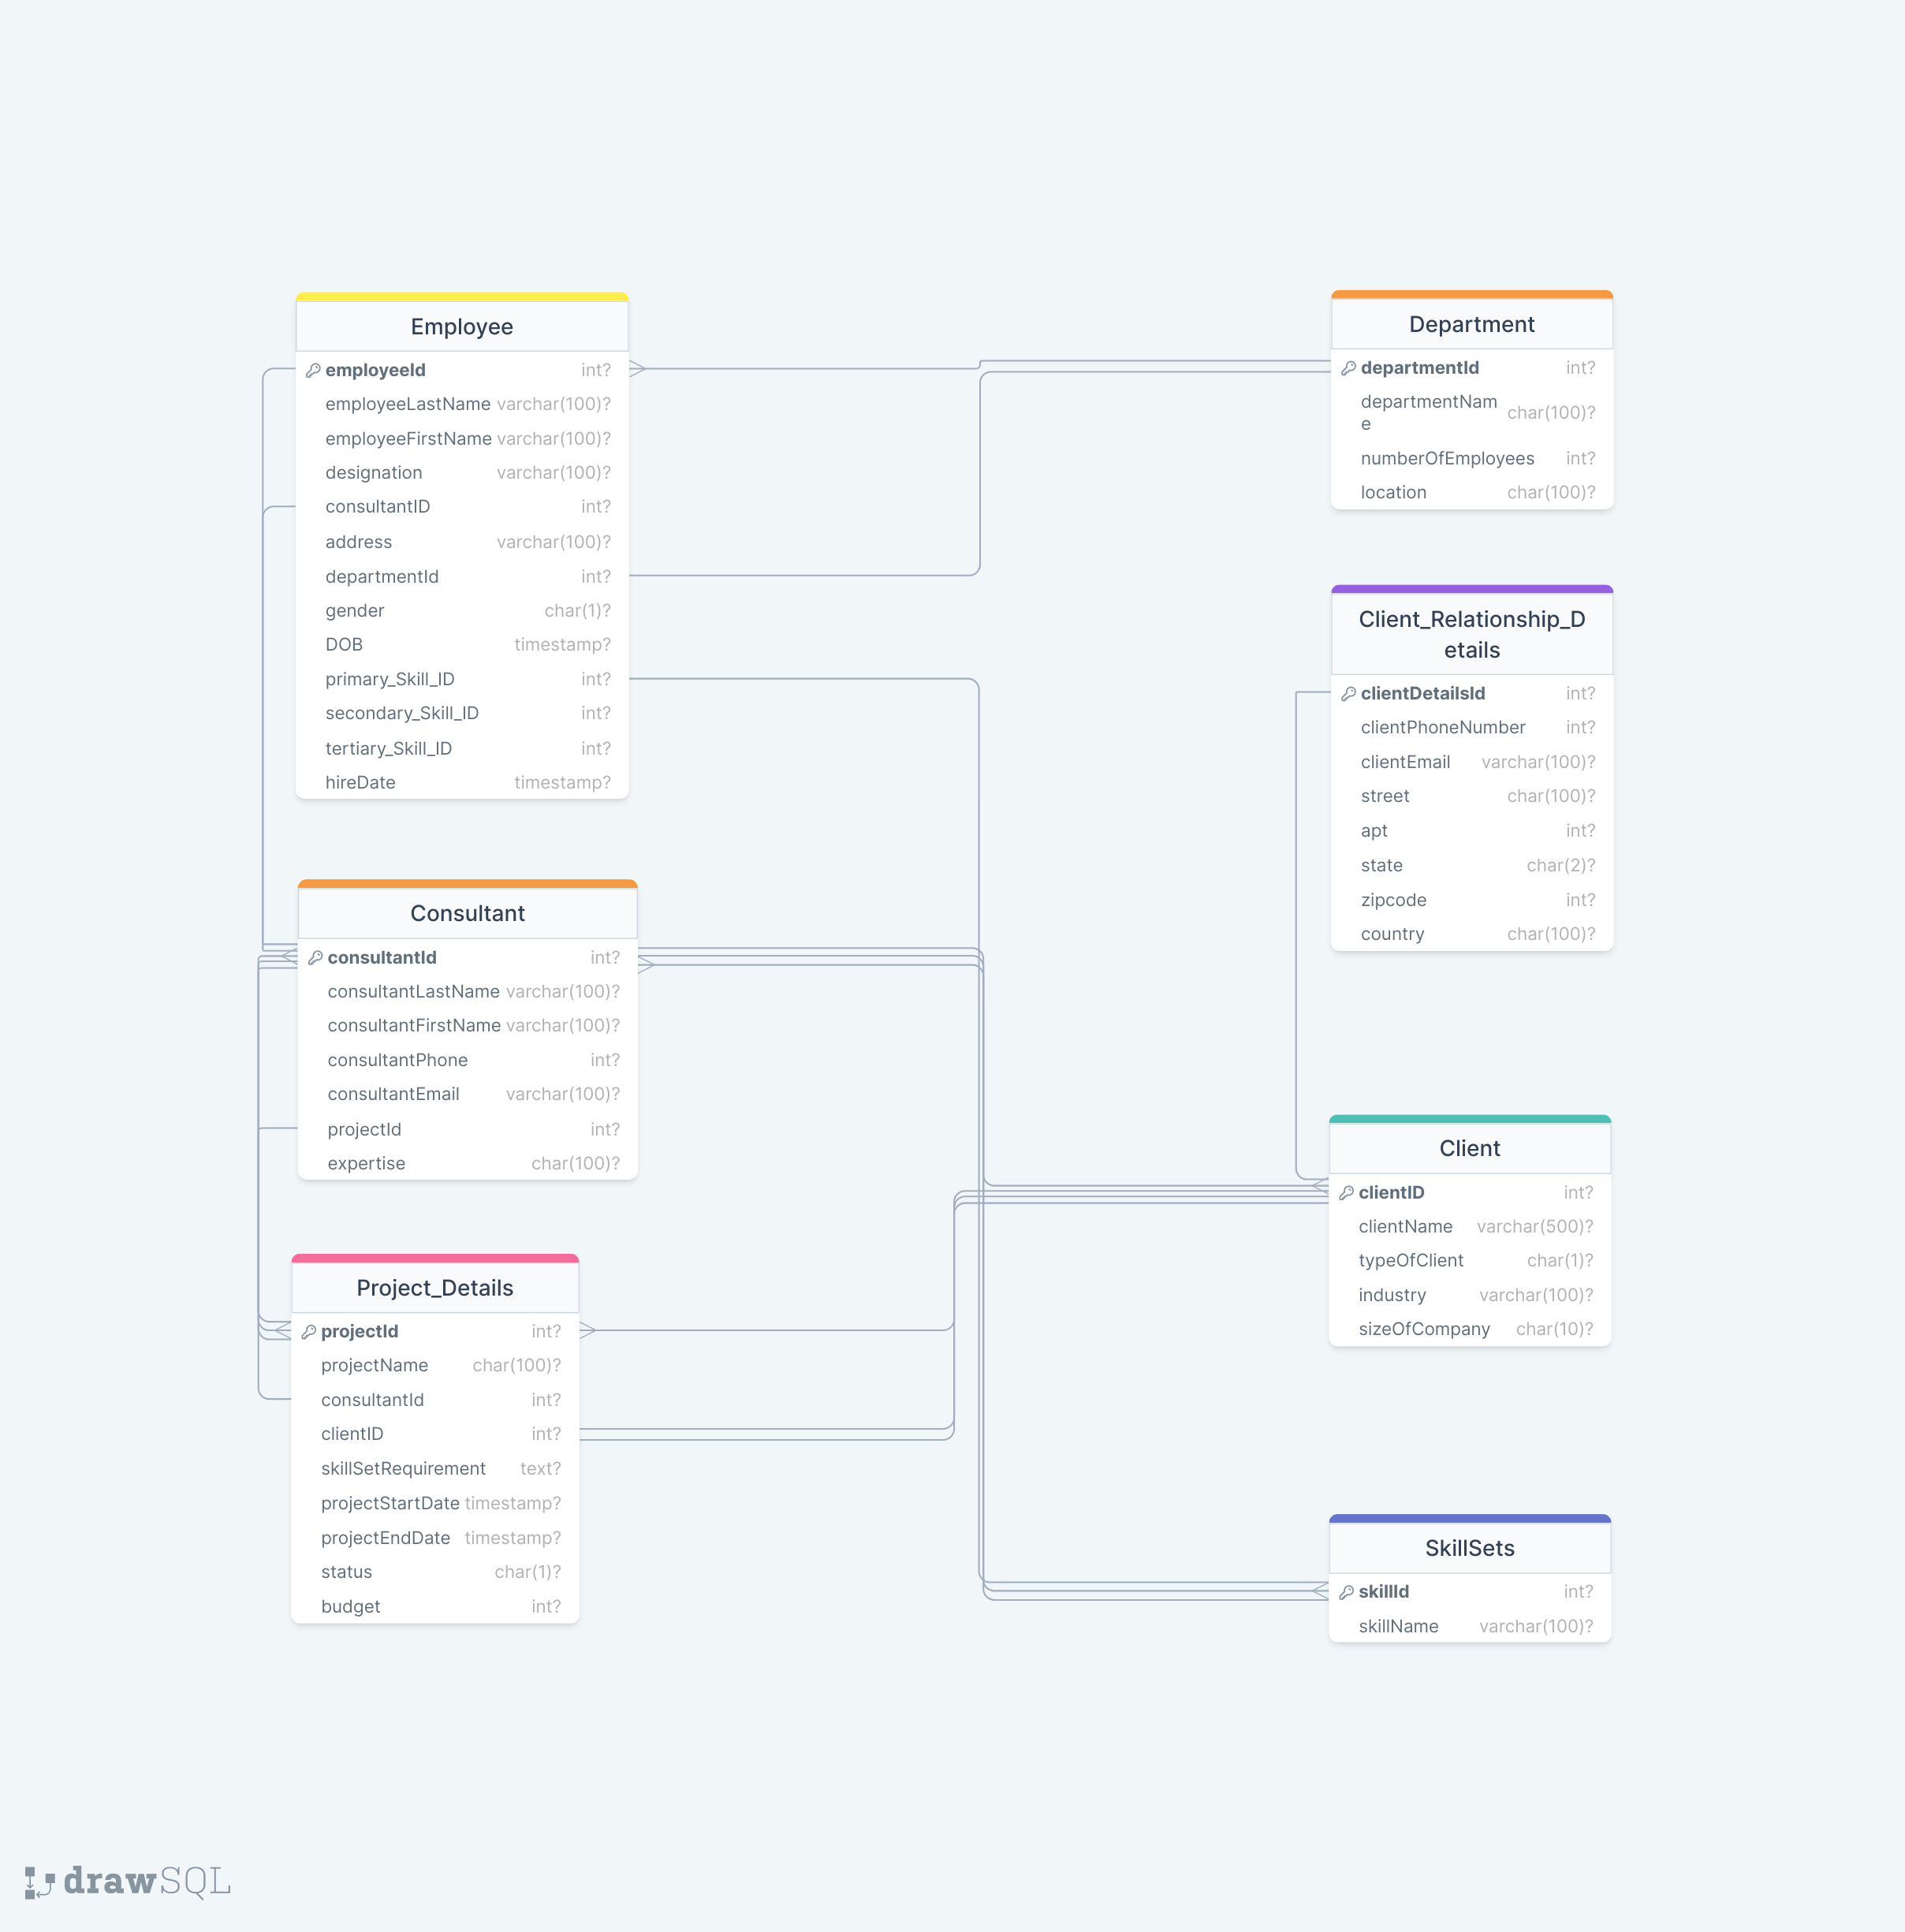

Slide 12
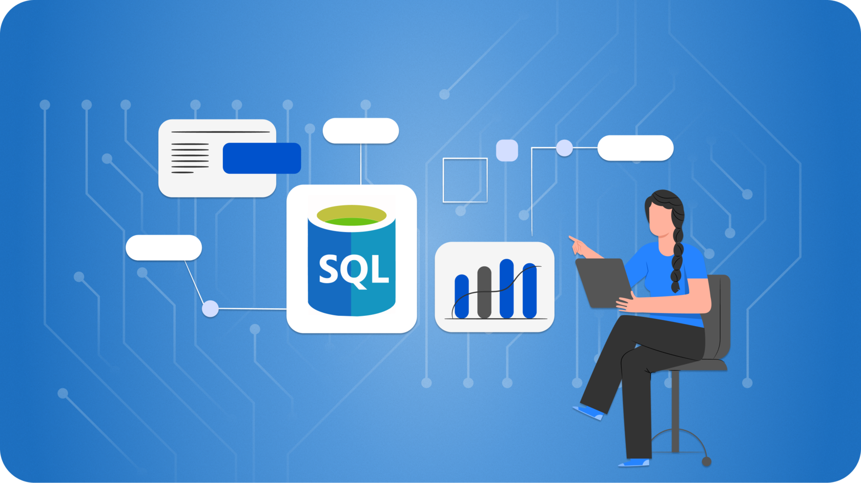
Here is the SQL Demo!

Slide 13
SQL Queries
DDL: CREATE, ALTER
DQL: SELECT
DML: INSERT, UPDATE

Slide 14
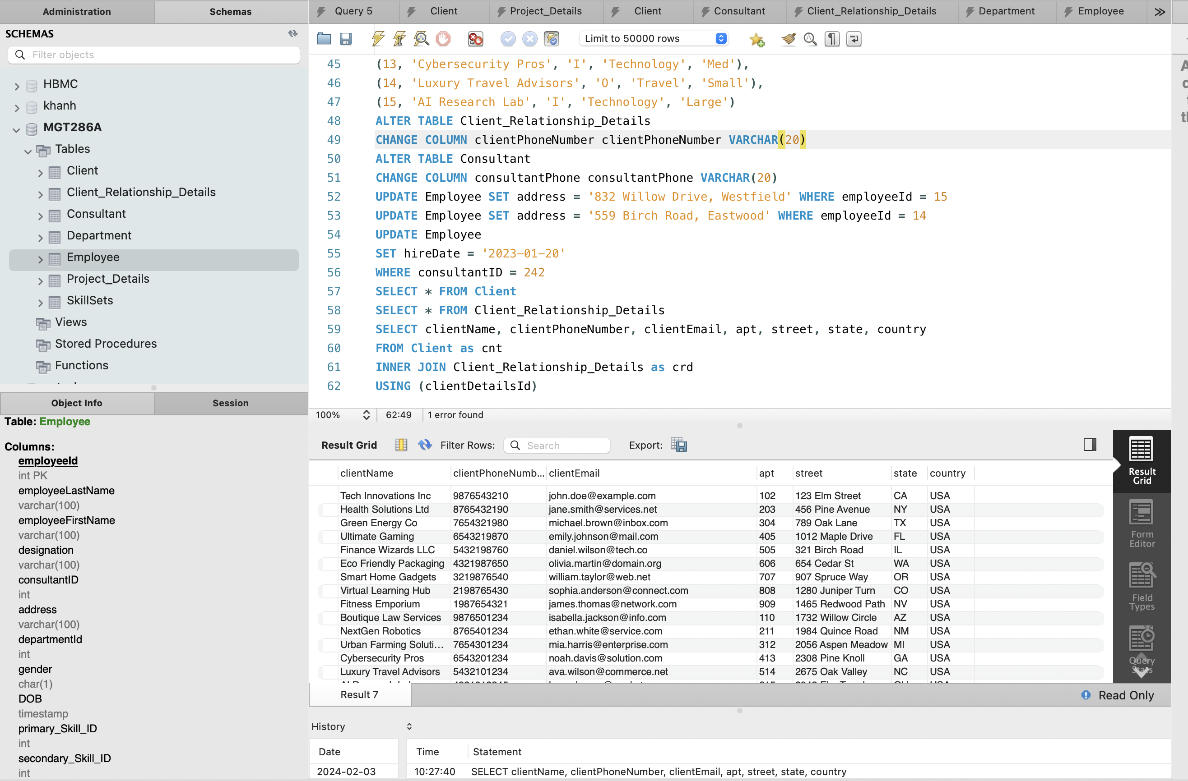
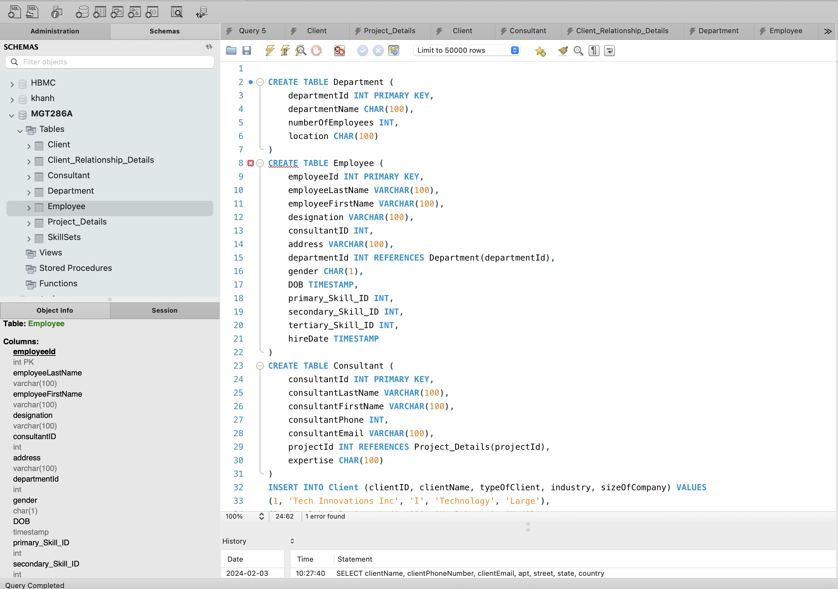
SQL Queries (cont.)

Slide 15
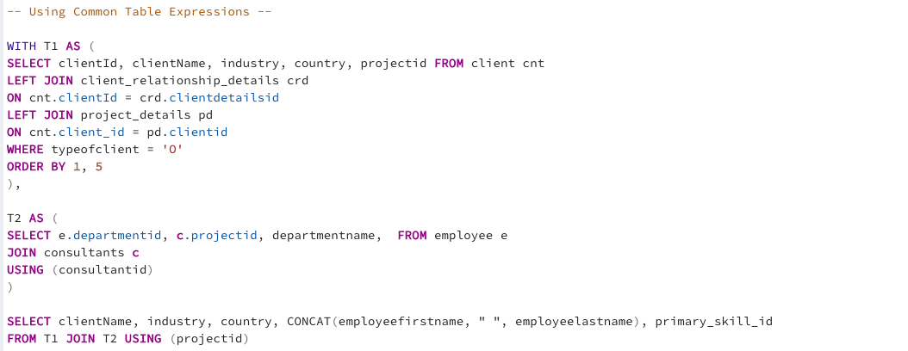
SQL Queries (cont.)

Slide 16
Conclusion & Future Scope
Establish a new set of tables linked to clientIDs to manage the financials for each company.
Expand storage for heavier client projects by adding client-specific tables/entities and optimize organization with separate data warehouses for each client.
Modify the database schema or attribute properties easily without major changes, thanks to its flexible mould-like structure.

Slide 17
Thank you!
Presented by
The Heptagon Consulting Group
MGT 286A

